Slide 1
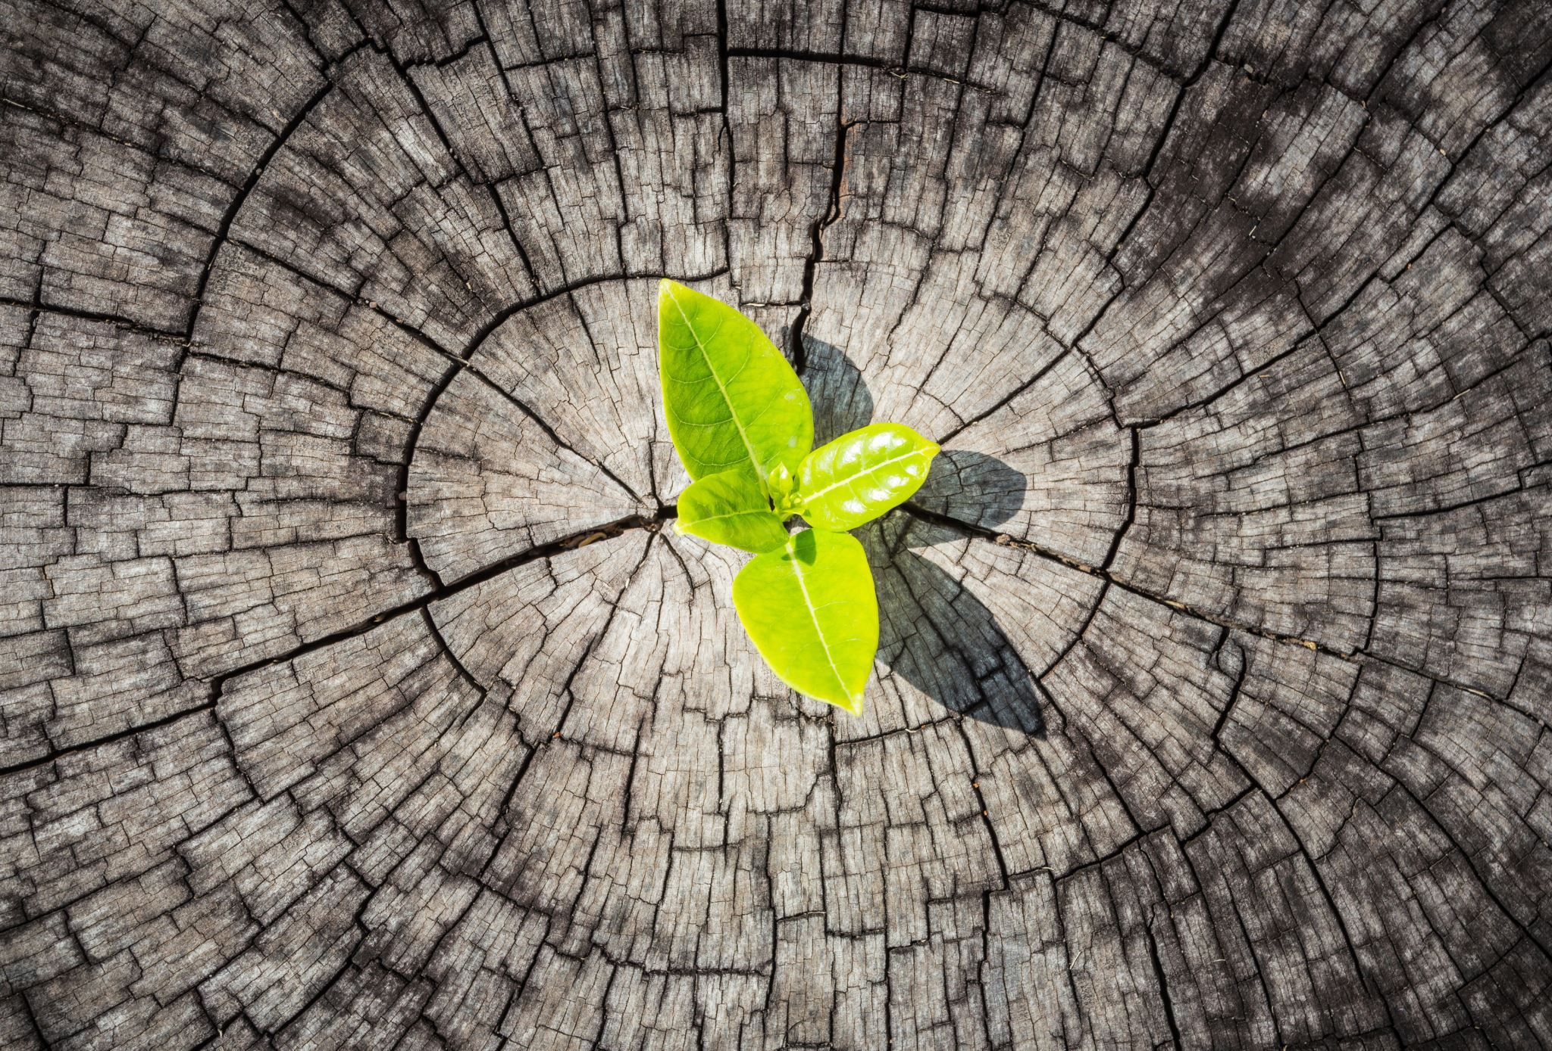
Plant disease classification
PAVAN KANTH KATTIKAM
UW75335
CAPSTONE PROJECT

Slide 2
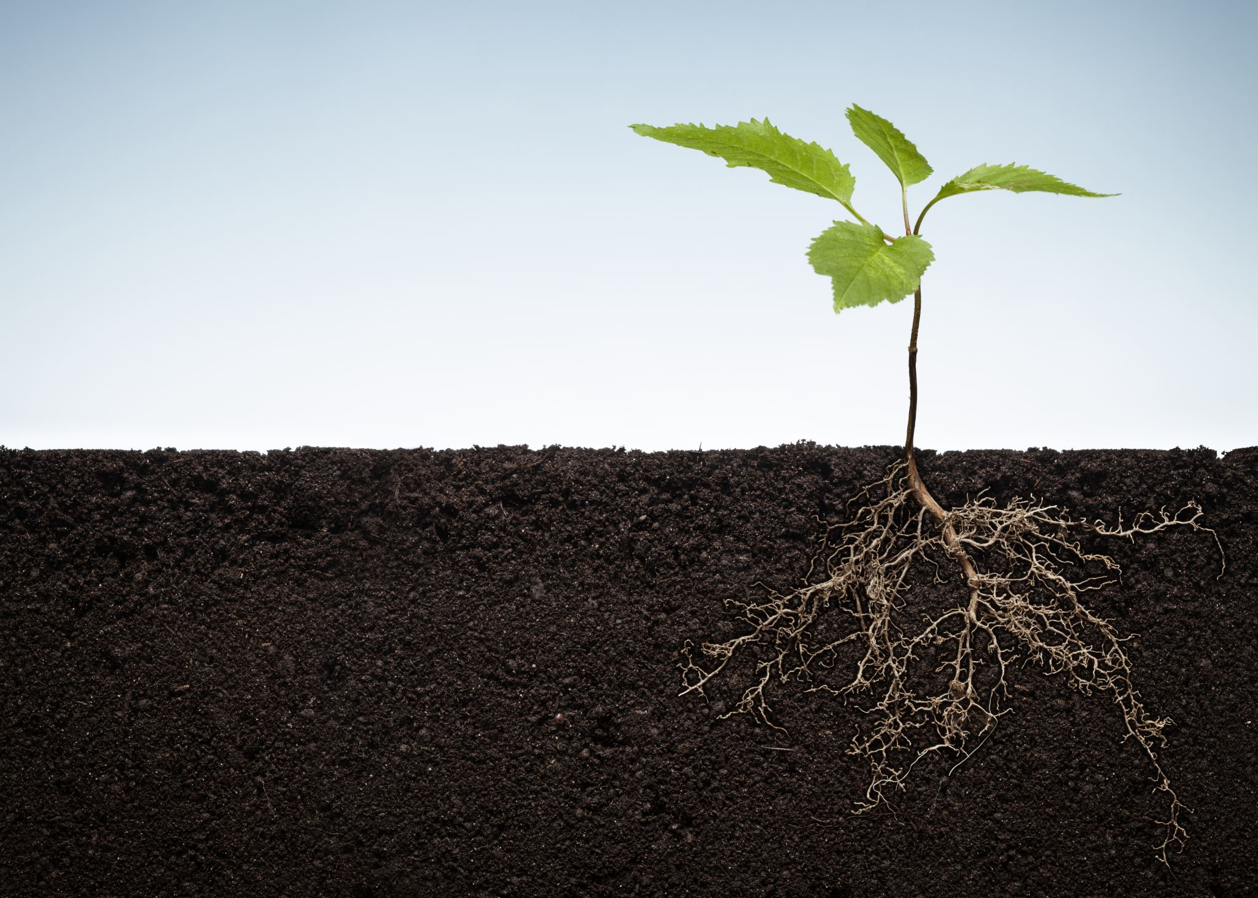
Problem Statement
The goal of this project is to develop a robust plant disease classification model for potatoes using Convolutional Neural Networks (CNN) and Residual Networks (ResNet). The primary objective is to accurately identify the presence of various diseases in potato plants from images.
Plant diseases pose significant threats to agricultural production and food security worldwide.
Identifying and diagnosing plant diseases manually can be time-consuming and prone to errors.
The objective is to build a plant disease classification model capable of distinguishing between healthy and diseased potato plants.
The two diseases of the potatoes are the early blight disease caused by the fungus and the late blight disease caused by micro-organisms.

Slide 3
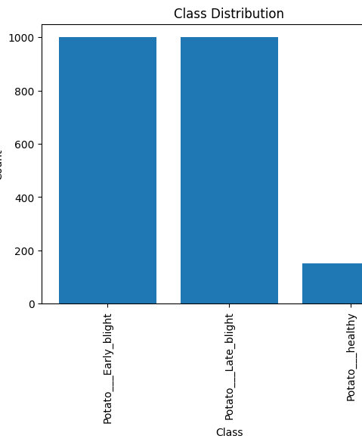
Data Set overview
The link of the data set is from Kaggle it is https://www.kaggle.com/datasets/arjuntejaswi/plant-village
https://github.com/codebasics/potato-disease-classification/blob/main/training/potato-disease-classification-model.ipynb
The dataset consists of a collection of images of potato plants affected by different diseases and healthy potato plants.
Each image is labeled with the corresponding disease class, such as "Potato___Early_blight," "Potato___Late_blight," and "Potato___healthy.“

Slide 4

Splitting the data and Model Training
The dataset consists of images categorized into 3 classes.
The split ratios are as follows:
Training set: 80% of the dataset
Validation set: 10% of the dataset
Test set: 10% of the dataset
Two deep learning models, CNN and ResNet, are utilized for plant disease classification.
Both models are trained using the training dataset.
Training is performed for 25 epochs.
The purpose of the validation dataset is to assess the model's performance during training.
The models are validated on the validation dataset at the end of each epoch.
Losses and accuracies of both the training and validation sets are computed and monitored.
The aim is to observe improvement in model accuracy with each successive epoch.

Slide 5
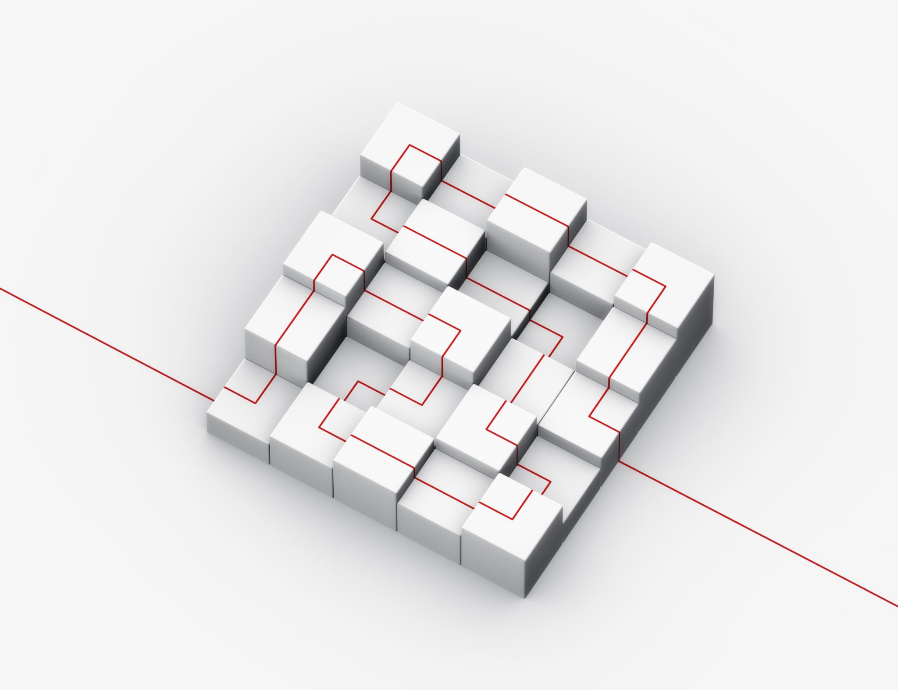
Accuracy of Models on Test Dataset
The two model architectures used in the classification of the problem are the CNN(Convolutinal Neural Network) built by 15 layers and RESNET(Residual Network) built by 33 layers.
The accuracy and the losses of both the scores on the test data set are
1. CNN loss for the test dataset is 0.2223 and the accuracy is 0.9297
2. RESNET loss for the test dataset is 0.0136 and the accuracy is 0.9961

Slide 6
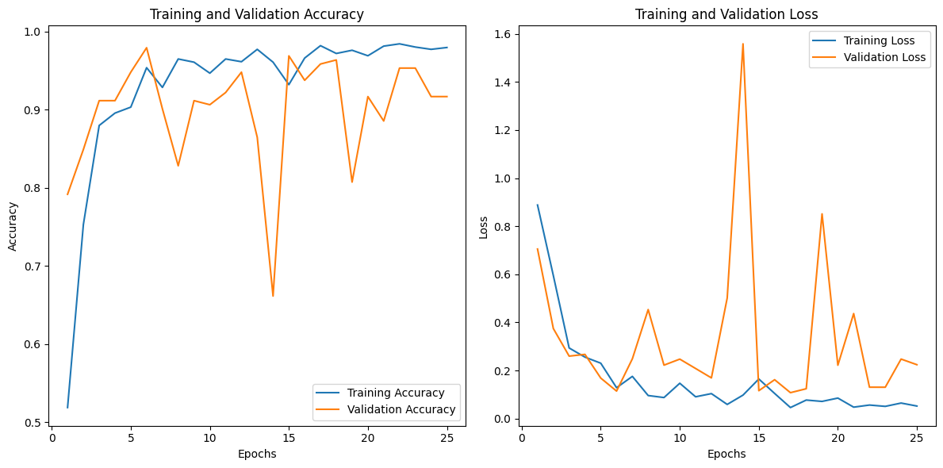
Training and Validation Accuracy and Loss of CNN

Slide 7
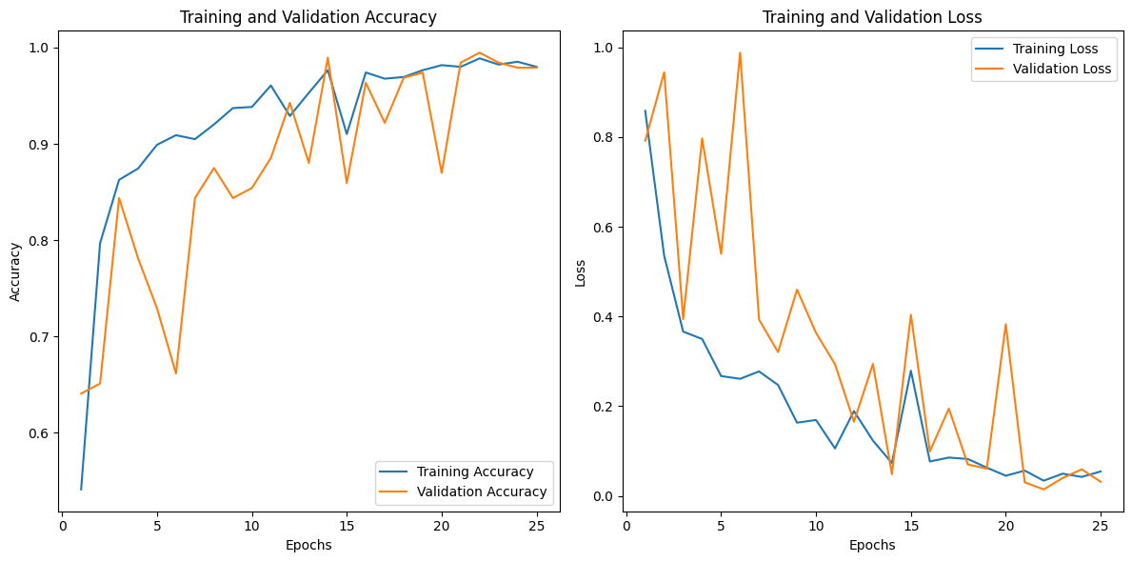
Training and Validation Accuracy and Loss of RESNET

Slide 8
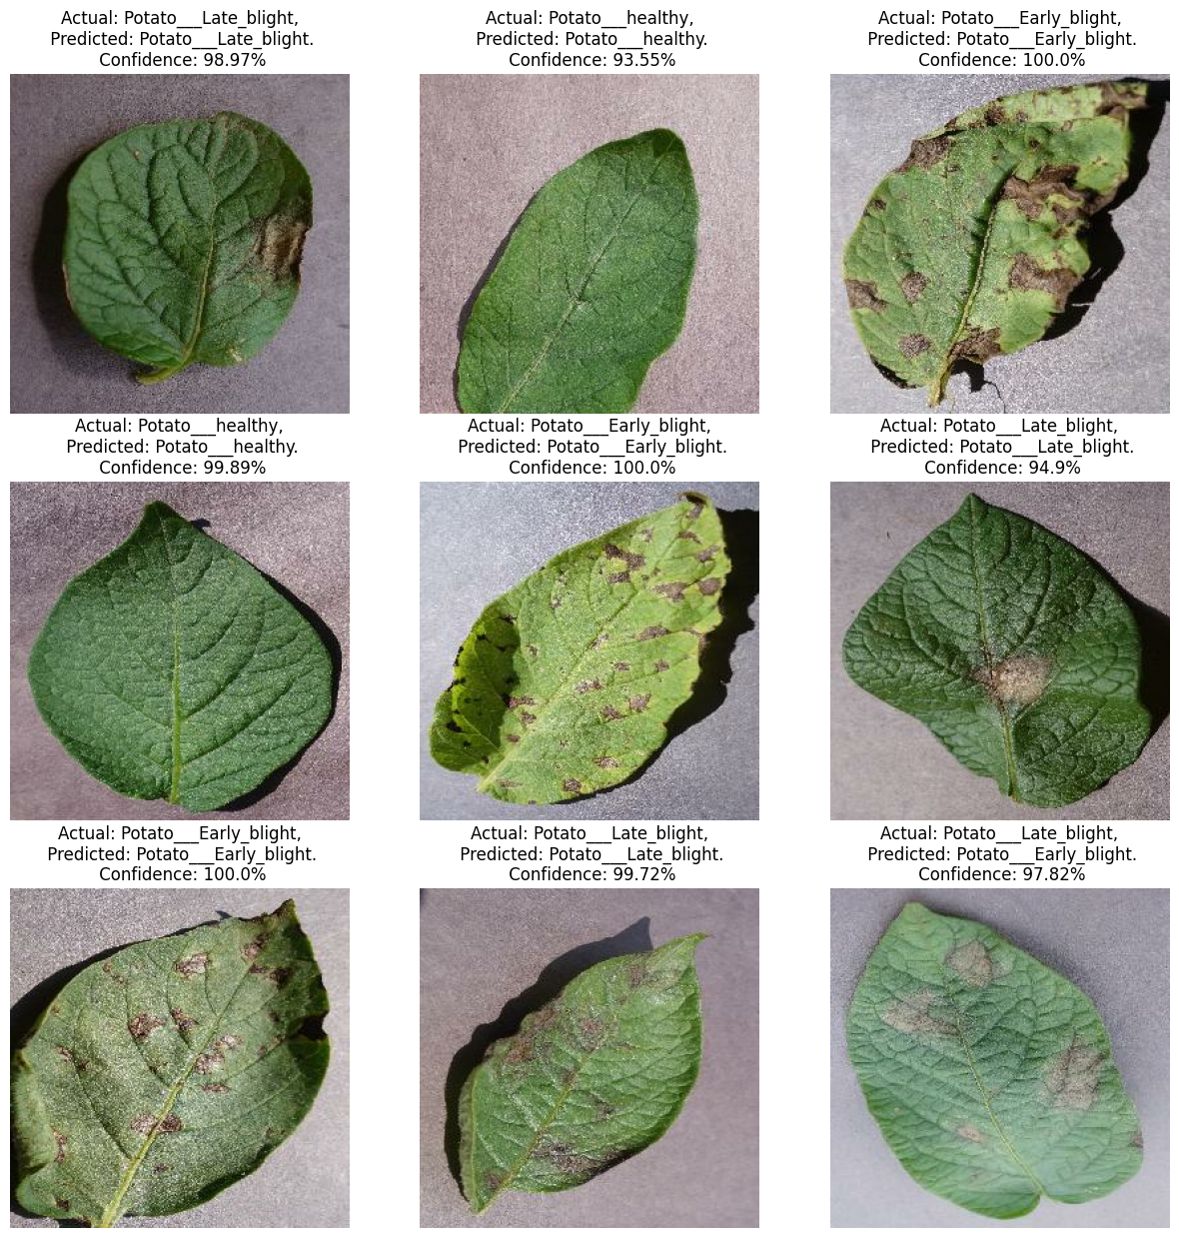
Predictions of the CNN Model on the test dataset

Slide 9
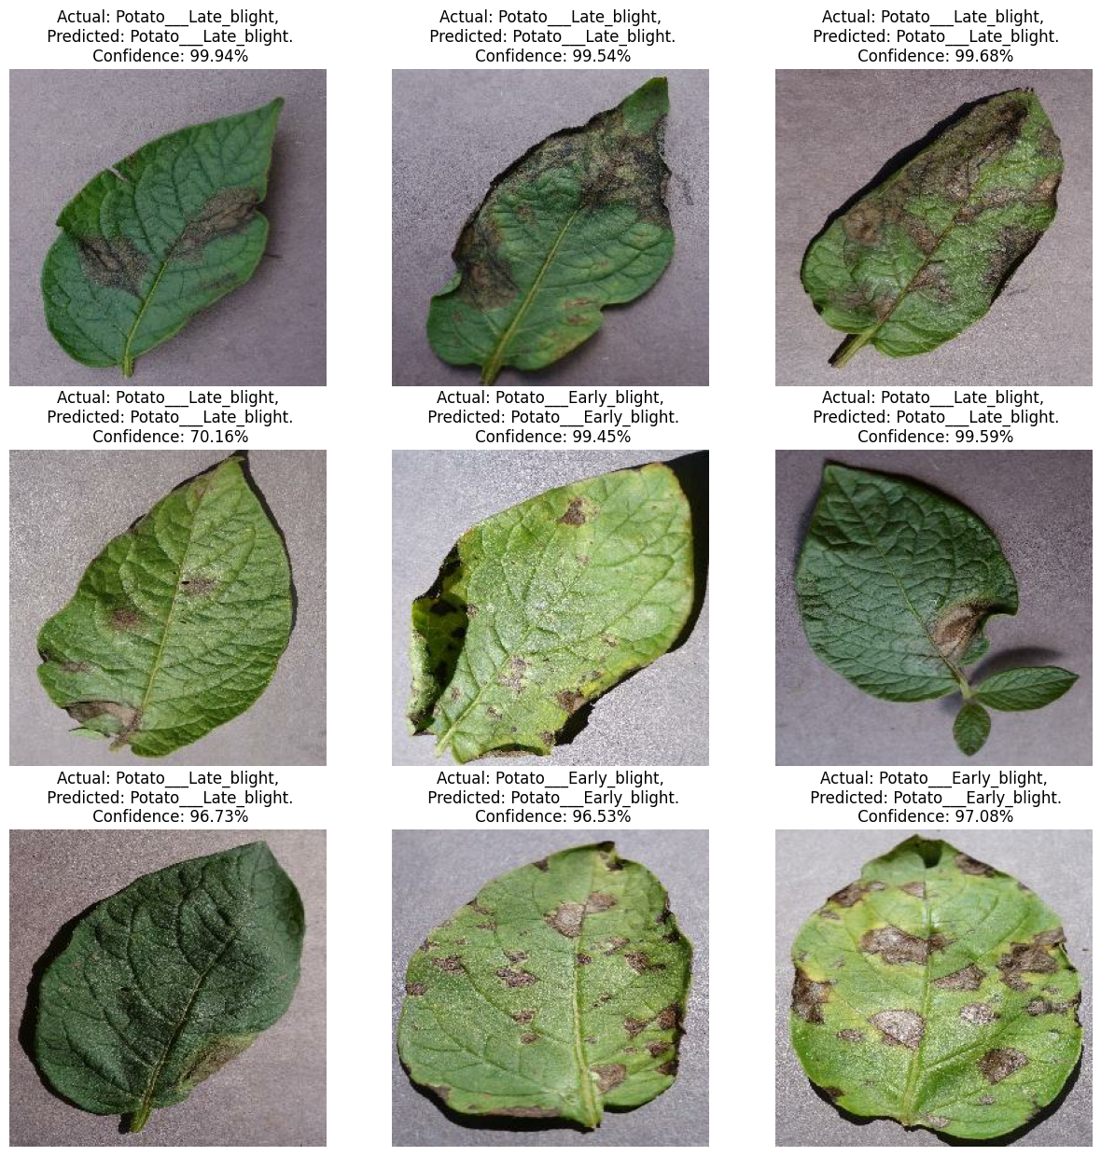
Predictions of the RESNET Model on the test dataset

Slide 10
Conclusions and the Results
Based on the comparisons of the two models the RESNET model performed better compared to the CNN Model with the more accuracy by testing it on the test dataset.
ResNets outperform CNNs by enabling deeper architectures, resolving vanishing gradients, and achieving state-of-the-art performance in image tasks.
The loss score of the trained CNN is more compared to the Resnet model on the test dataset.
The confidence level and the probability predictions of the CNN Model is better in all the predictions.

Slide 11

Future Goals
Deployment of trained models for real-world applications.
Web and mobile application development planned for farmers' use.
User-friendly interface for uploading images of plant leaves.
Processing of images using trained models to provide disease predictions.
Future focus on empowering early detection and prevention of plant diseases.
Contribution to improving agricultural practices and reducing crop losses.
Development of a user-friendly interface, intuitive and easy to navigate.
Continuous improvement with user feedback to enhance the application.

Slide 12
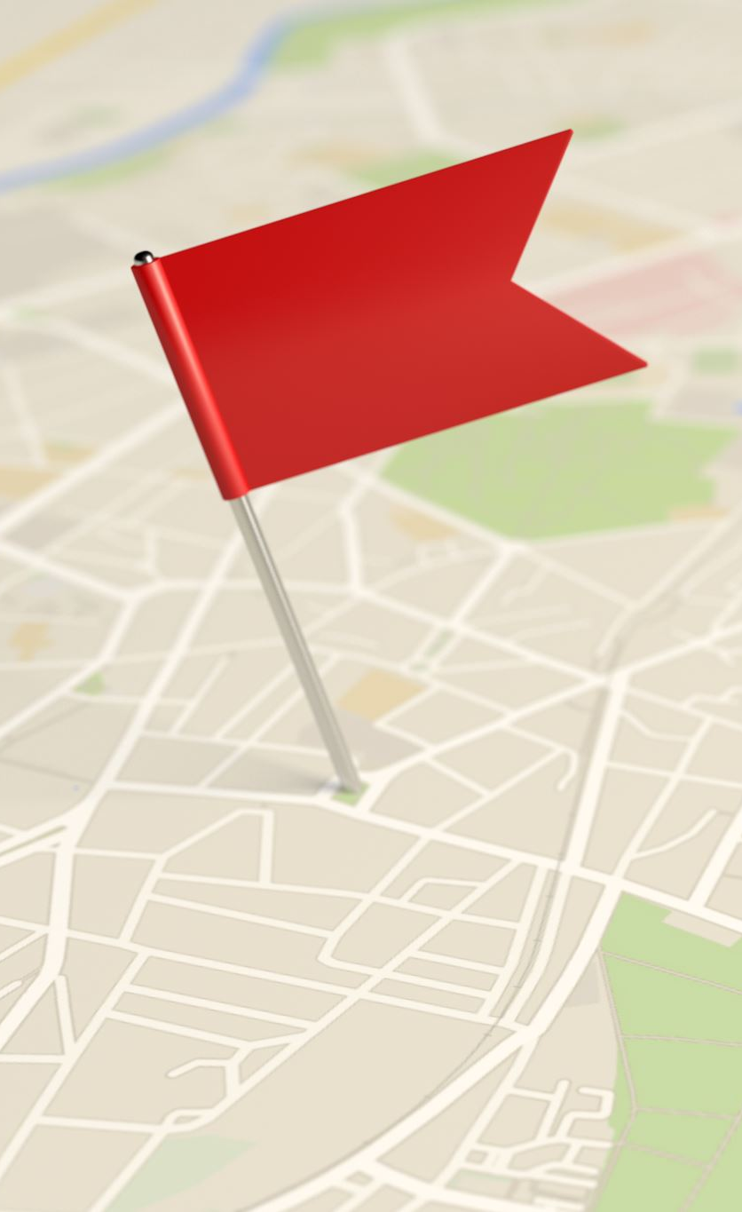
REFERENCES
[1] https://github.com/codebasics/potato-disease-classification/blob/main/training/potato-disease-classification-model.ipynb
[2] https://www.kaggle.com/datasets/arjuntejaswi/plant-village
[3] https://www.mdpi.com/2073-4395/12/10/2395#:~:text=With%20the%20advent%20of%20machine,original%20characteristics%20of%20an%20image.
[4] https://plantmethods.biomedcentral.com/articles/10.1186/s13007-021-00722-9

Slide 13

Thank you

